Slide 1
Data Science Assignment
TATA Communications

Slide 2
Agenda For Problem Statement 1
Model Evaluation Plots
Model Interpretation and recommendations(Bonus)
Agenda For Problem Statement 2
Instructions/commands to run the API locally.

Slide 3
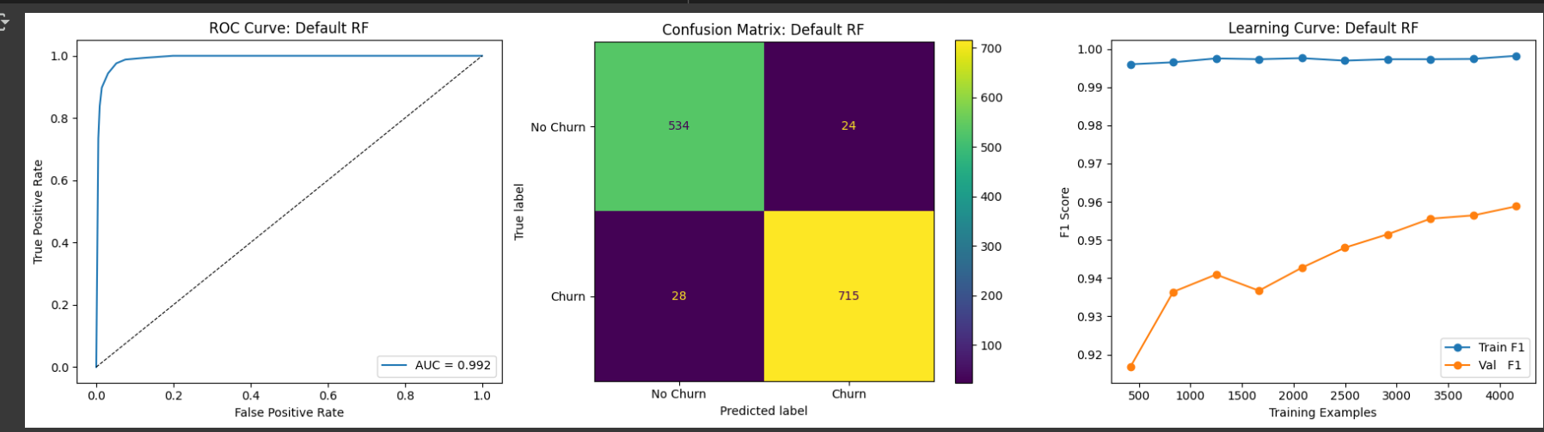
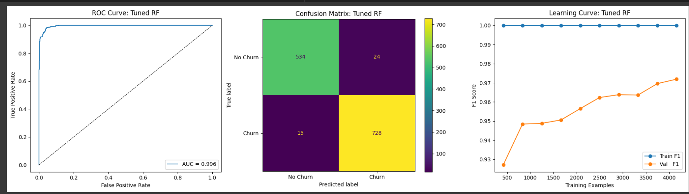
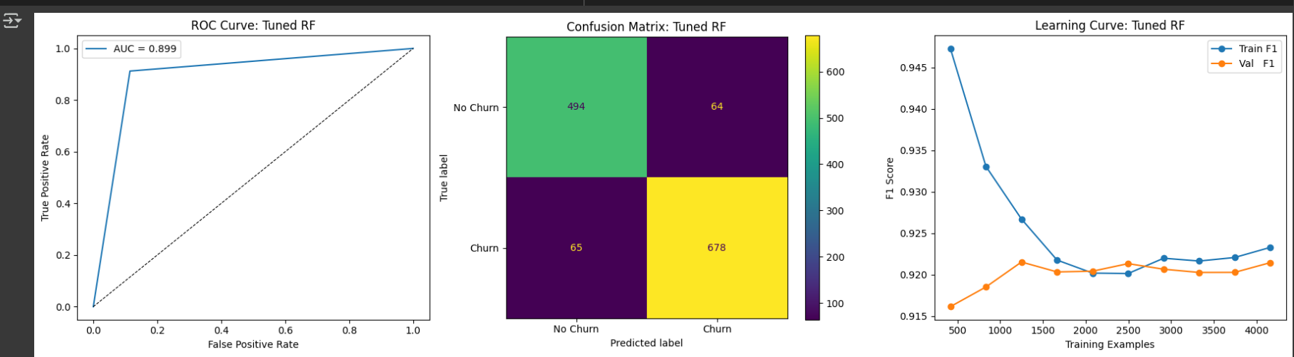
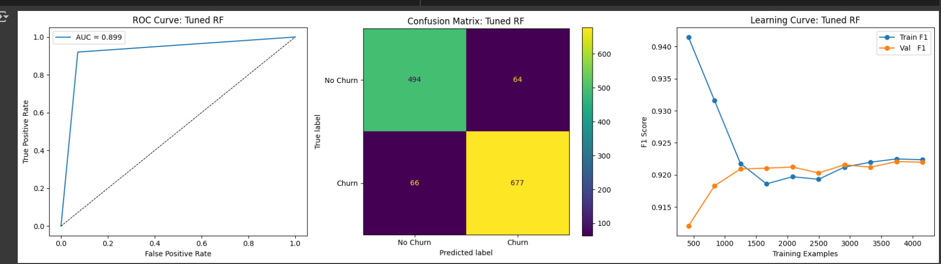
Model Evaluation
Random Forest model
Hyperparameter Tuned Random Forest model
Logistic Regression model
Hyperparameter Tuned Logistic Regression model

Slide 4
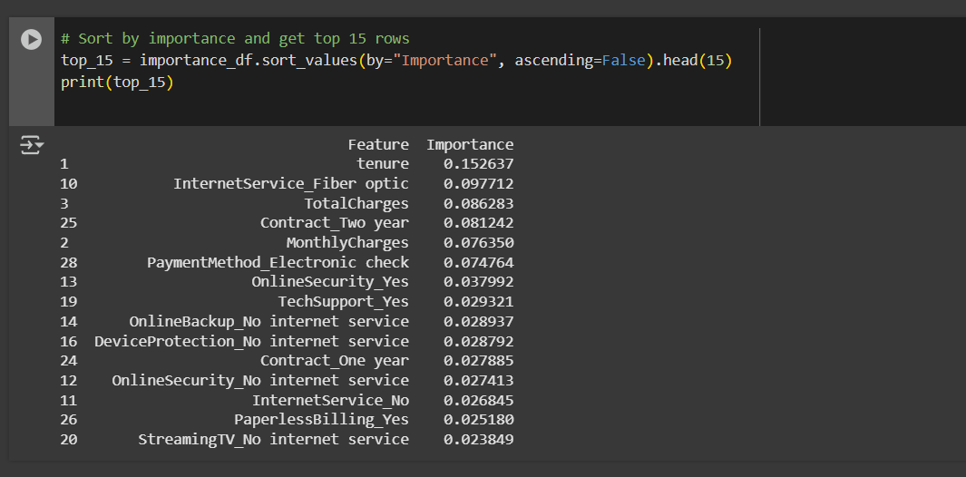
Model Interpretation and recommendations
Through this we can say that these features has high importance in the target Variable(Churn). Here the business should focus on these features to minimize the churn of a customer for long term Customer satisfaction and Revenue stability.

Slide 5
Instructions/commands to run the API locally.
Run FastApi Locally : python fastapiapp.py
Building Docker Image : docker build –t customerchurn_Assignment .
Run the containerized application : docker run -d -p 8000:8000 customerchurn_assignment
Check Container Status : docker ps –a

